Slide 1
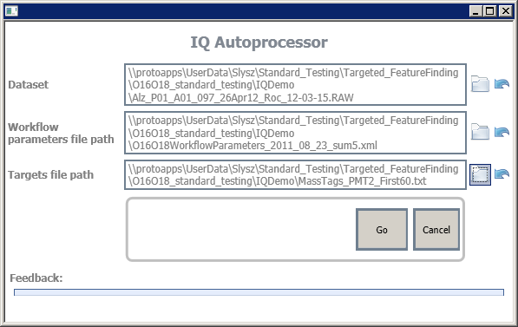
IQ Autoprocessor - Inputs
Select dataset (click the folder or enter the path manually)
Select workflow parameter file. This is an IQ .xml parameter file
Select the targets .txt file. IQ will load these targets and iterate over them.
For PNNL users: see demo files here:
\\protoapps\UserData\Slysz\Standard_Testing\Targeted_FeatureFinding\O16O18_standard_testing\IQDemo

Slide 2
IQ Autoprocessor - Outputs
Two files are outputted:
a _results.txt file containing the results from IQ processing. [TODO: add new slides explaining columns]
a _log.txt file containing some logging information. This file can be opened as the file is being processed.
Output location: currently same folder as RAW file
[TODO: add option for output folder]

